Slide 1
Key Distribution &
Diﬃe-Hellman key exchange
Adopted from “Cryptography and Network Security” by W. Stallings

Slide 2
Key Distribution Problem
How to distribute public key securely
Why is there a need to distribute secret keys with the aid of the public key
How Diﬃe-Hellman key exchange works

Slide 3
Distribution of Public Keys
Typical public keys can be distributed as follows:
public announcement
publicly available directory
public-key authority
public-key certificate
Notes:
Special Attention Required

Slide 4
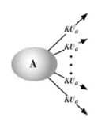
1. Public Announcement
Users distribute public keys to recipients or broadcast to community at large
Append PGP keys to email messages and send across network
Post PGP keys on news groups or email list
Various site that support PGP keys as part of user proﬁle (e.g. facebook)
Convenient and works well for small scale distribution but…
Weakness → forgery
Anyone can create a key claiming to be someone else and broadcast it
Adversary can masquerade as claimed user until discovered

Slide 5
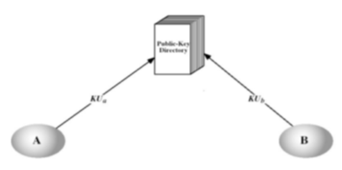
2. Publicly Available Directory
Directory must be trusted with properties:-
contains {name,public-key} entries
participants register securely with directory
participants can replace key at any time
directory is periodically published
Can publish entire directory or just changes to directory
directory can be accessed electronically
directory must be trusted
Greater security as compare to method (1) but still vulnerable to tampering or forgery
Pretend to be authorised directory or
Change records in directory

Slide 6
3. Public-Key Authority
Improved security → tighten control over distribution of keys from directory
A central authority maintains a dynamic directory of public keys of all participants
Requirements:-
Authority must be secured
All users must know the public key of the directory (authority) with only the authority knowing the corresponding private key
Real-time access to directory (authority) when keys are needed (aka always ON server)
Issues:-
Authority can become bottleneck
Records maintained can also be tempered with

Slide 7
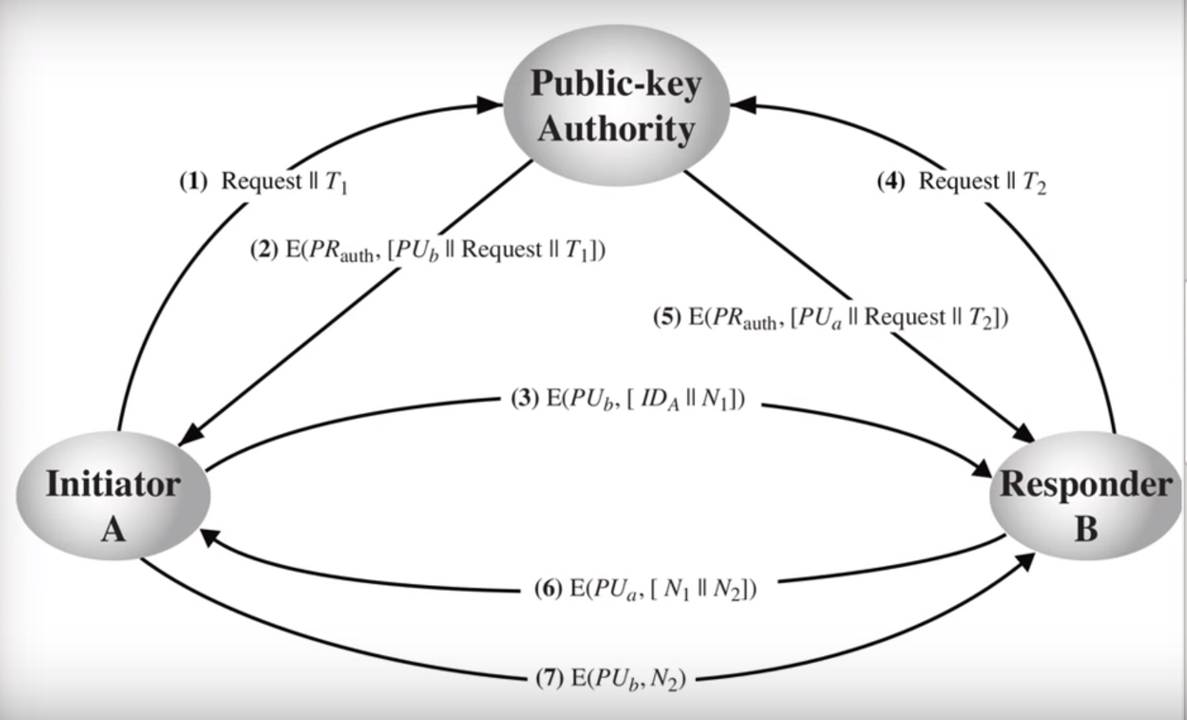
3. Public-Key Authority (Cont)
A and B know their key pair. Public / Private keys and so is the Authority
7 steps protocol
sign
sign
A and B published their public key to Authority
verify
verify
Authority verify all pubic keys are correct
A and B know the public key of Authority
Message 3, 6 and 7 are for A and B to confirm they are talking to the right party
E : Encryption / Signing the message (if is from Authority)
N : Some random value that hard to predict

Slide 8
4. Public-Key Certificates
To overcome bottleneck in (3), we can use Public-Key Certificates
Allow key exchange without real-time access to public-key authority
Binds identity to public key
with other info such as period of validity, rights of use etc
Public-Key signed by a trusted Certificate Authority (CA) can be veriﬁed by anyone
Public-key of CA is publicly available

Slide 9
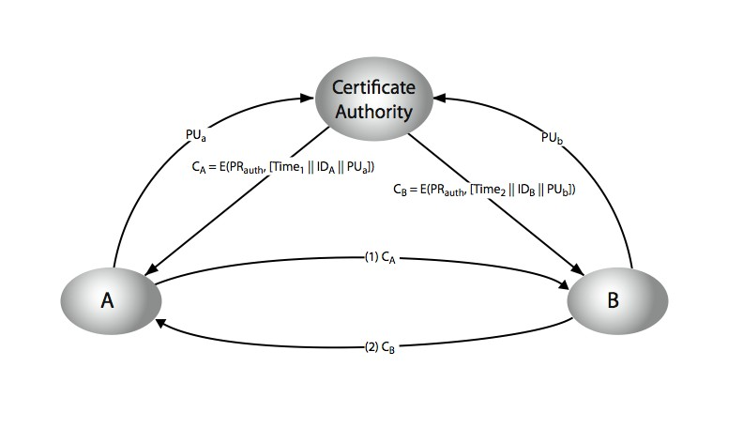
4. Public-Key Certificates (Cont)
When A and B want to communicate, the only message that need to be sent is (1) and (2)
M3
M1 to M4 happen in advance way before message (1) and (2)
M1
M2
M4
This is why the performance is improved greatly as now only (1) and (2) is required for A and B to exchange message. No message goes to Authority during communication
M1 & M3:
Users store public keys with CA
M2 & M4:
CA provides certificates to users
Certificate is a document contains user’s public key, CA’s signature, time stamp(validity of cert.) as well as identity of user
Certificates exchange between A and B is issued by Certificate Authority or CA
CA not involved in communication
Certificates received are verified using CA’s public key

Slide 10
Certificate

Slide 11
Key Exchange

Slide 12
Sharing Secret Keys securely with the aid of Public-Key
Public-key encryption
Need long key to be effective (aka hard to break) --→ Slow / CPU intensive
Alternatively, use a secure way to exchange a secret (or session) key
Encrypt the message based on the secret / session key

Slide 13
Diﬃe-Hellman Key Exchange
First public-key scheme proposed
by Diﬃe & Hellman in 1976
Note: Williamson (UK CESG) secretly proposed the concept in 1970
DH is not for data secrecy or authentication
DH key exchange is a practical method for public exchange of a secret key (shared value)
Notes:
Special Attention Required

Slide 14
Diﬃe-Hellman Key Exchange
Source : http://stackoverflow.com/questions/28015433/is-it-possible-to-hack-diffie₁-₃ hellman-by-knowing-the-prime-number-and-the-gene
Notes:
Special Attention Required
The simple reason for both side can come to the same answer of '8':
Bob choose 5 to be his private key and the corresponding public key of it is also 5 , because it is based on 11 ^ 5 mod 23
Alice chooses 6 to be her private key and the corresponding public key of it is 9 , it is based on 11 ^ 6 mod 23
When Bob applies the formula : shared key = K = Alice's public key ^ Bob's private key mod p = 9 ^ 5 mod 23 = ((11 ^ 6 mod 23 ) ^ 5) mod 23
It is equivalent to 11^6^5 mod 23 = 8
When Alice applies the formula : shared key = K = Bob's public key ^ Alice's private key mod p = 5 ^ 6 mod 23 = ((11 ^ 5 mod 23 ) ^ 6) mod 23
It is equivalent to 11^5^6 mod 23 and => 11^5^6 mod 23 = 8

Slide 15
Diﬃe-Hellman Key Exchange
DH Features
Establish a common key (session key) known only to the two participants
Value of key depends on the participants (and their
private and public key information)
Properties:-
Cannot be used to exchange an arbitrary message.
It should be:-
Computationally easy : Forward processing
Exponentials modulo a prime or a polynomial
Computationally hard : Reverse processing
Discrete logarithms

Slide 16
Diﬃe-Hellman Setup
All users agree on global parameters:
p is large prime integer
g is a primitive root modulo of p
Each user (eg. Alice) generates his / her key
chooses a secret key (number): x_{A} < p
Each user makes public key
– Alice’s public key: y = g^{xA} mod p
A
– Bob’s public key: y = g^{xB} mod p
B
Notes:
Special Attention Required

Slide 17
Diﬃe-Hellman Key Exchange
Shared session key for users A & B = K_{AB}:
K
_{= g}^{x}A.^{x}B
mod p
AB
x_{B}
= y_{A} mod p mod p
(which B can compute) (which A can compute)
= y ^{xA}
B
K_{AB} is the session key in private-key encryption scheme between Alice and Bob
Subsequent communications between Alice and Bob will have the same key as before (unless they change their public-keys)
Attacker must solve discrete log to get X_{A} or X_{B}
Notes:
Special Attention Required

Slide 18
Diﬃe-Hellman Example
Users Alice & Bob who wish to swap keys:
Agree on prime p=353 and g=3
select random secret keys:
– A chooses x_{A}=97, B chooses x_{B}=233
compute respective public keys:
y_{B}=3
compute shared session key as:
– y =3⁹⁷ | mod | 353 | = | 40 | (Alice)
A – 233 | mod | 353 | = | 248 | (Bob)
– K = y ^{xA} mod353 =248⁹⁷mod353=160 (Alice)
AB B_{xB}
233
– K_{AB}= y_{A} mod353 =40
mod353=160 (Bob)
Notes:
Special Attention Required

Slide 19
Key Exchange Protocols
If the public-key is properly secured in a central directory (aka with PKI)
Other users could query the public-key, compute the secret key, communicate.
Authentication of user is possible (because of the PKI)
DH key exchange attacks
Replay attacks (with / without PKI)
Man-in-the-middle attacks (without PKI)

Slide 20
Summary
How to distribute public keys using
Announcement , public directory, public-key authority and public-key certificate authority
Why is there a need to distribute secret keys (session key) with the aid of the public key.
Diﬃe-Hellman key exchange calculation, features and attacks

Slide 21
Thank you

Slide 22
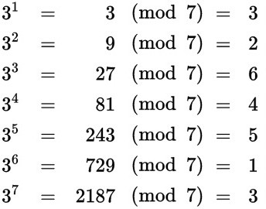
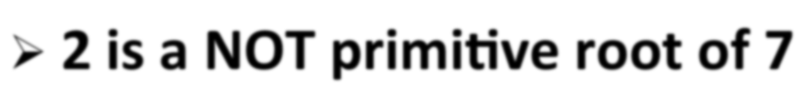


Primitive root
3 is a (g) primitive root of 7 (p- prime)
When g¹ (mod p) to g^{(p-1)} (mod p), there is all numbers range from 1 to (p-1), then g is the primitive root of 7 i.e 3, 2, 6, 4, 5, 1
2 is a NOT primitive root of 7
1, 2, 4, 1, 2, 4, 1, 2, 4...missing values 3, 5, 6

